Slide 1
COMPUTER PROGRAMMING PROJECT PRESENTATION
MEMBER’S NAME
MUHAMMAD ALIFF HAIKAL
AHMAD KHALILULLAH
MUHAMMAD ILHAM HADI

Slide 2
OBJECTIVE
Create a program by using the Boolean value if statement and logical operators.
Modify the program for suitable use of if…else statements.
Use the sub-function arguments, whether passing by value or reference in the program.
Produce the requested results of this project

Slide 3
PROGRAM C++
{
value(length);
perimeter = Perimeter(length, perimeter);
cout << fixed;
cout << showpoint;
cout << setprecision(2);
cout << "Perimeter= " << perimeter << endl;
area = Area(length, area);
cout << fixed;
cout << showpoint;
cout << setprecision(2);
cout << "Area= " << area << endl;
cout << "Press (y/Y) to stop the program " << endl;
cin >> y;
cout << endl;
}
while ((!y== 'y')||(!y=='Y’));
}
// (khalil,ilham,aliff)// (project JD22)// (11/11/22)
#include <iostream>
#include <iomanip>
using namespace std;void value(float&);
float Area(float, float);
float Perimeter(float, float);
int main()
{
char y;
float length = 1;
float area = 2;
float perimeter = 3;
do

Slide 4
PROGRAM C++
//sub program 1
void value(float & length)
{
cout << endl;
cout << "Length: " << endl;
cin >> length;
if (length < 0)
{
cout << "Please enter a positive, (+) value" << endl;
cin >> length;
}
cout << endl;
}
//sub program 2
float Perimeter(float length, float perimeter)
{
perimeter = length * 4;
return perimeter;}
//sub program 3float Area(float length, float area)
{
area = length * length;
return area;
}

Slide 5
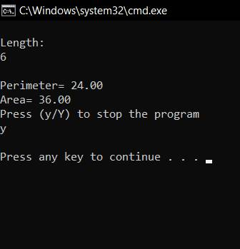
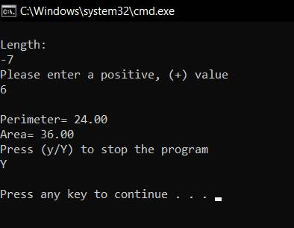
OUTPUT

Slide 6
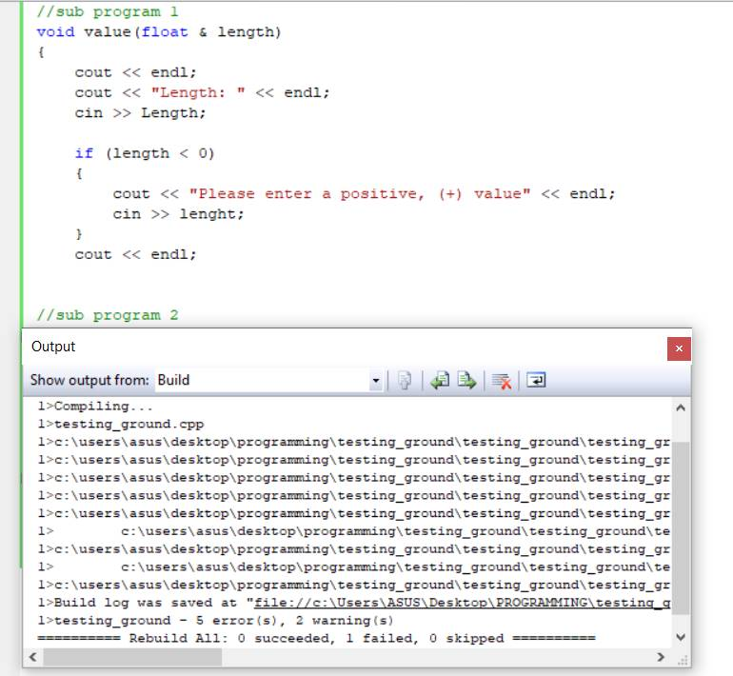
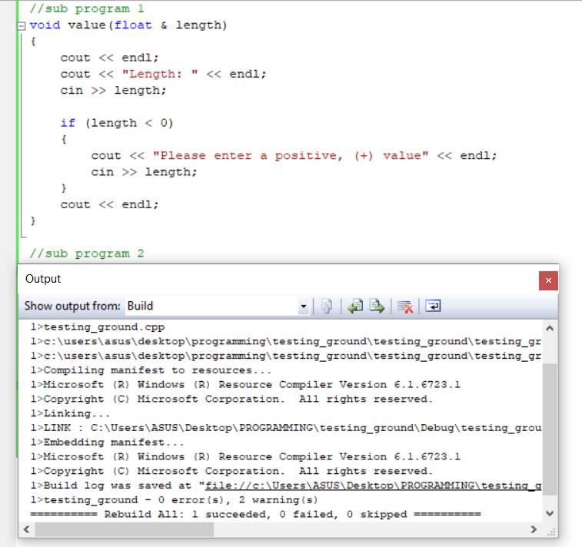
COMPILATION ERROR
Problems:
No semicolon(;) & curly bracket({})
Improper variable declaration
Solutions:
Proper programming format [(semicolon,;)&(curly bracket,{})
Improper variable declaration

Slide 7
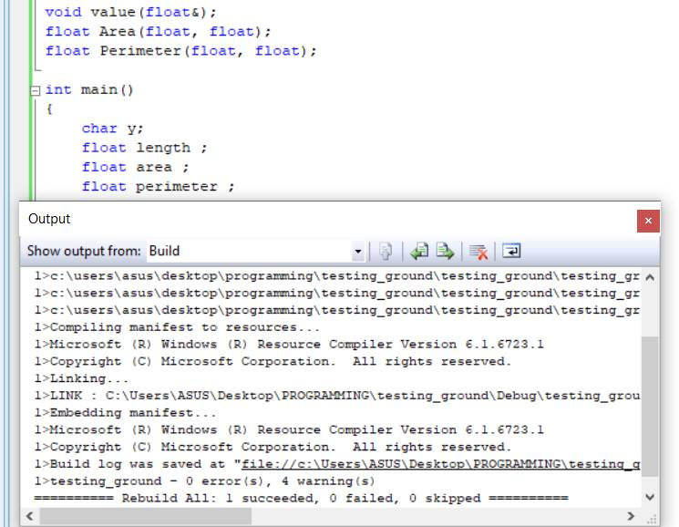
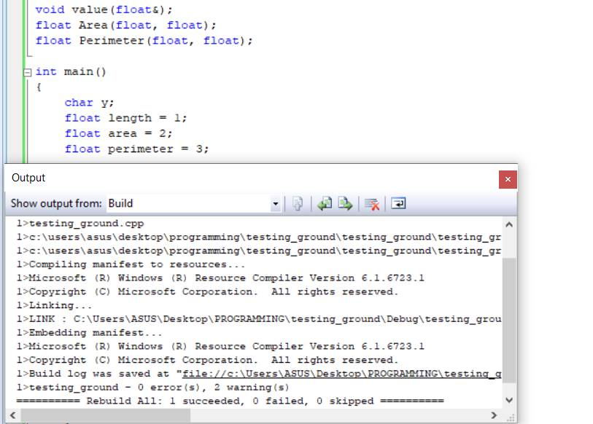
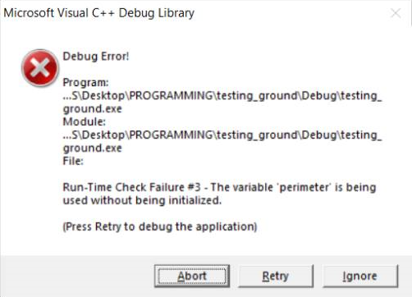
RUN-TIME ERROR
Problems:
Program cannot run properly even no error is detected
Solutions:
Use dummy number at the variable

Slide 8
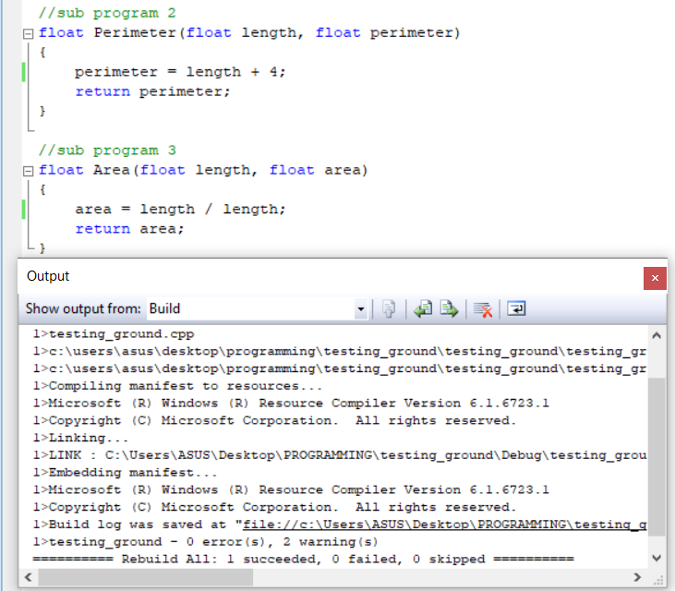
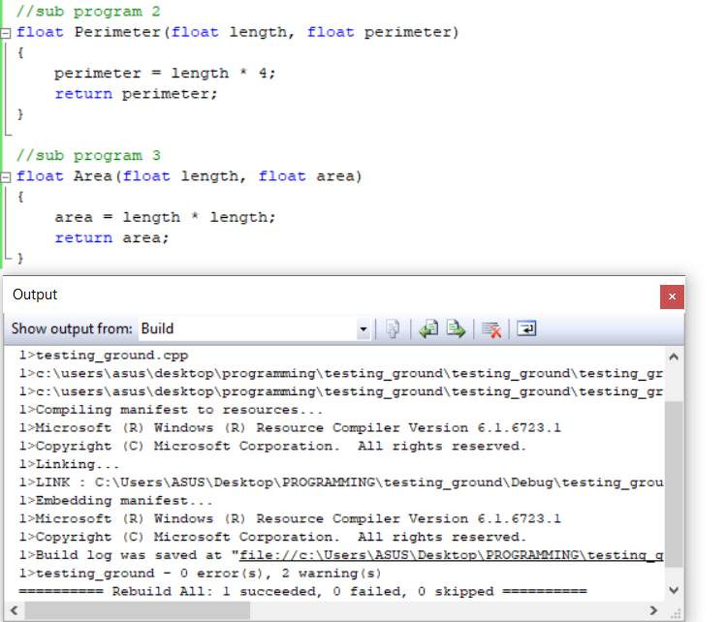
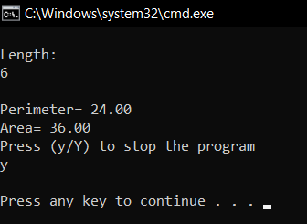
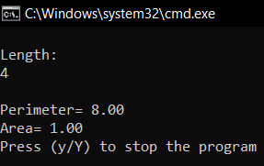
LOGICAL ERROR
Problems:
Output does not same as calculation
Solutions:
Use proper mathematical formula

Slide 9
CONCLUSION
We use do while statement to display the calculated value of area and perimeter.
The function header specifies the return value type, function name, and parameters of the function.
We use void statement to check if the users put the right value in positive.
Set precision will display the output program in an organized manner

